Slide 1
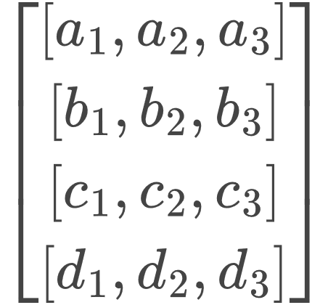
A Single FULL Query
A Single token Query

